Slide 1
Receptacle
Developed By : Falcons

Slide 2
CONTENTS
Objective
Problem Statement
Technologies Used
Prototype
End User
Future Enhancement

Slide 3
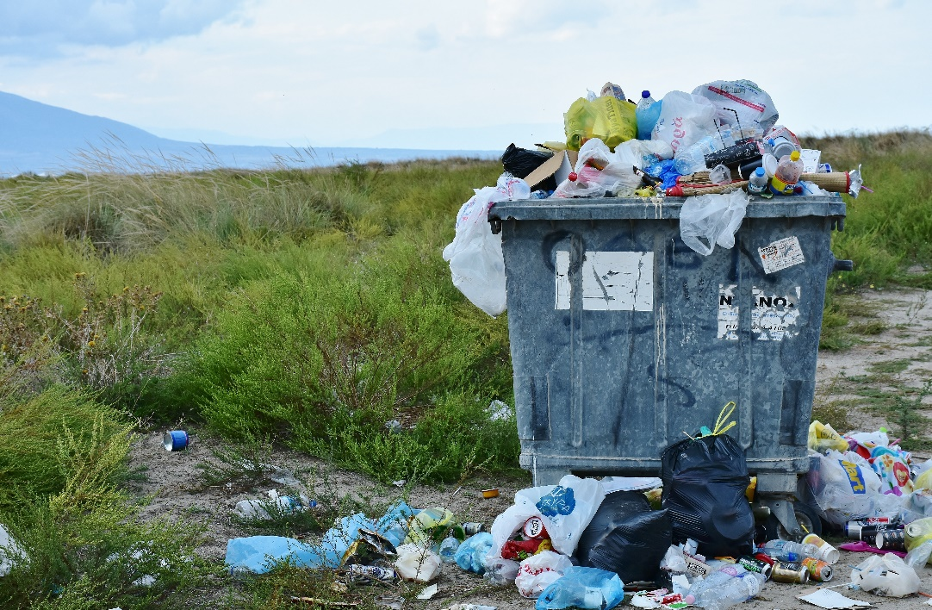
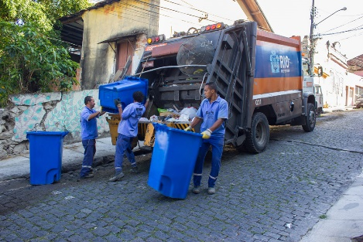
OBJECTIVE
To develop an app that ensures the adequate collection and treatment of garbage with sustainable methods.
Making a healthier and cleaner society.

Slide 4
Problem Statement
Land Pollution affects human health.
Toxic material pollutes the soil.
Bacteria , Insects grow from garbage and spread diseases
Garbage contaminates surface water.

Slide 5
How do we solve the problem
The name Receptacle.
By distributing the task of garbage collection.
By introducing a transparent system – Approval and Processed states.
By involving an individual, the municipalities and treatment companies.

Slide 6
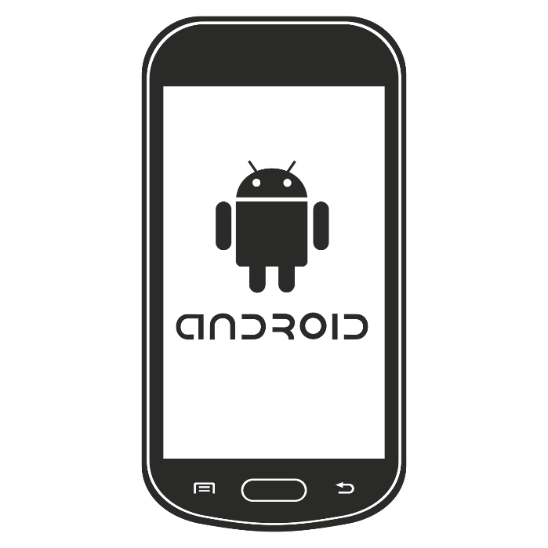
Users
Anybody with an Android phone

Slide 7
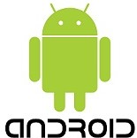

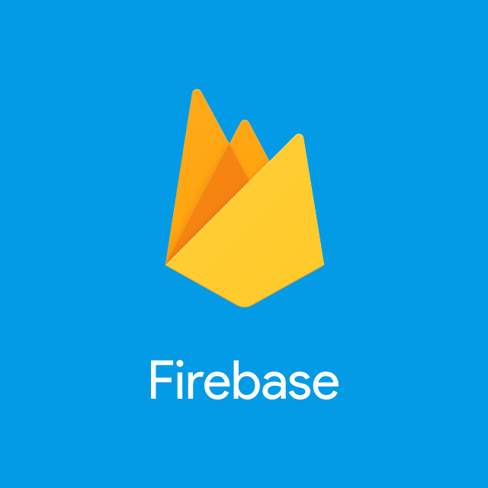
TECHNOLOGIES USED
Android
Java
Firebase
Adobe Photoshop

Slide 8
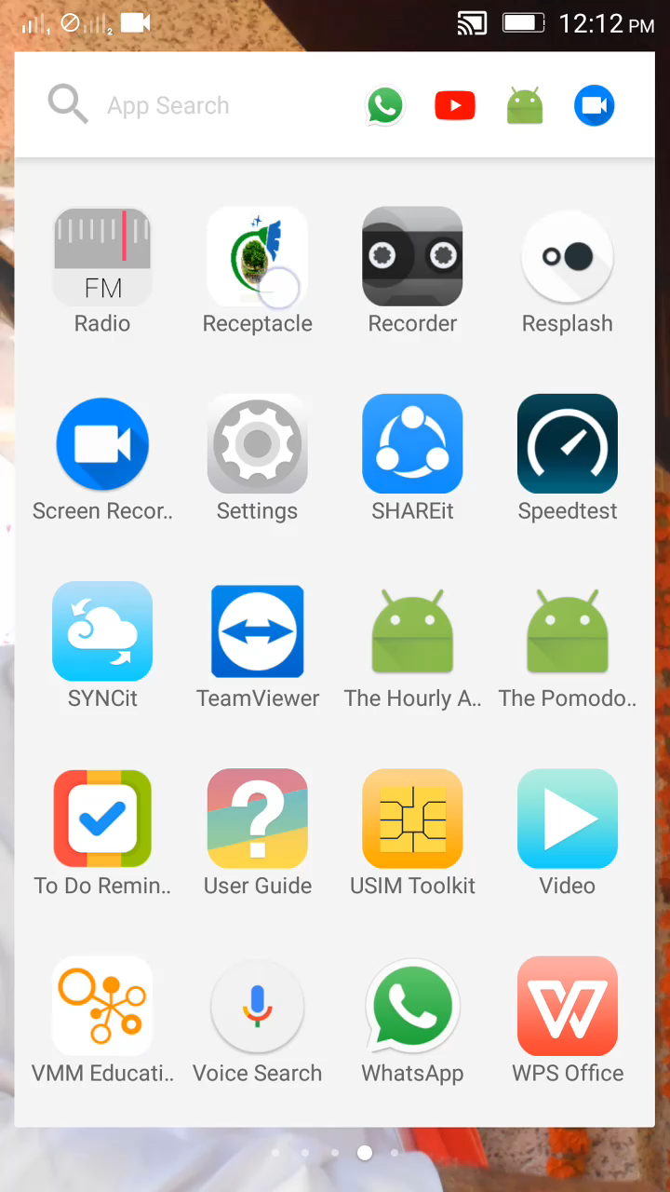
Prototype

Slide 9
Future Enhancements
Inserting a Feedback loop on the user end.
Promoting the idea of cleanliness worldwide.

Slide 10
Thank You

